Slide 1
Electric Vehicle Adoption and Barriers in Washington State
Sayed Murtadha Alawi
DAB-16

Slide 2
Agenda
Problem statement
EV Barriers
Approaches
Recommend
Analysis
Limitations

Slide 3
Problem Statement
Washington has over 39.3 million registered vehicles, but only 6% of them are electric. This large gap highlights uneven EV adoption across the state and slows progress toward reducing emissions and transitioning away from ICE vehicles.

Slide 4
Approaches
Population size across counties
Political Leaning Assessment
Analyze median income by county
Vehicle Registration Analysis

Slide 5
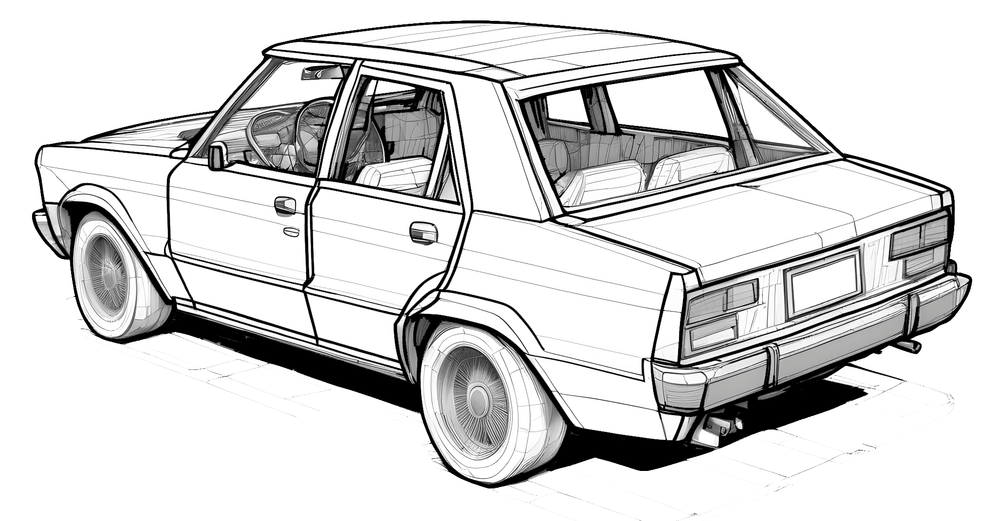
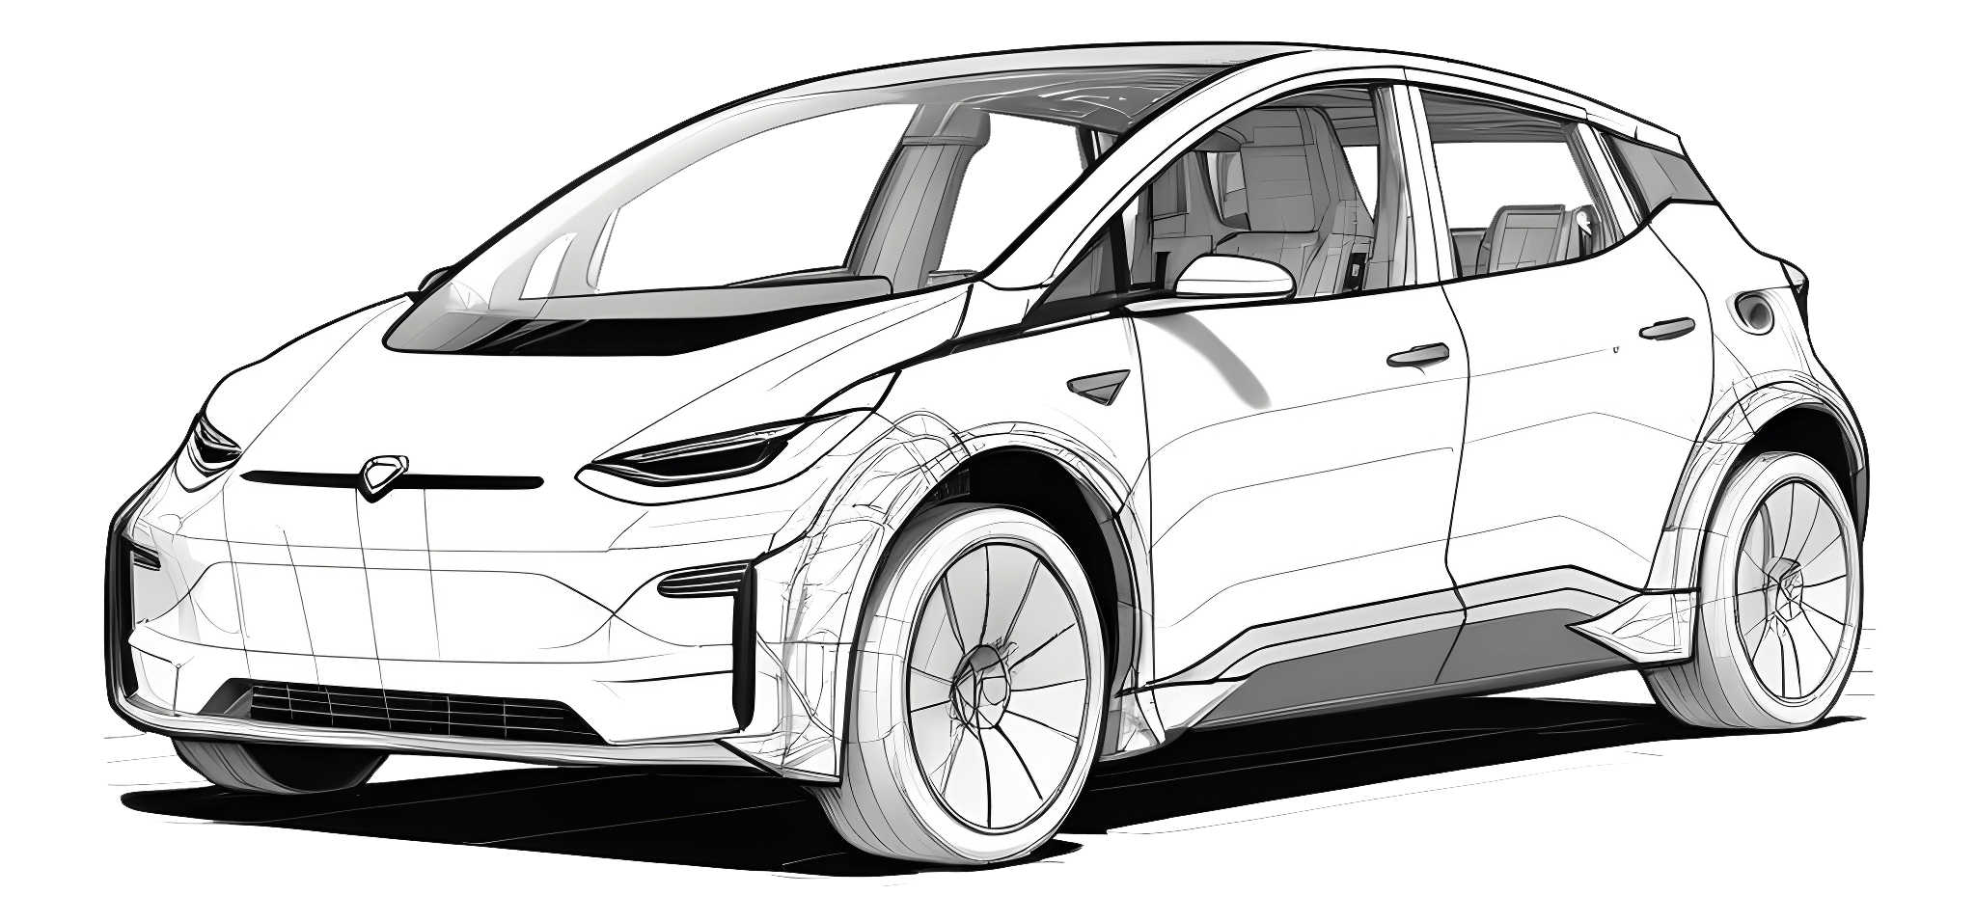
HEV | Hybrid | ICE
Runs fully on electricity Zero tailpipe emissions Higher upfront cost; depends on charging availability | Larger battery + fuel engine Can drive short distances on electricity alone Still produces emissions when engine is used | Runs only on gasoline or diesel Higher emissions and fuel consumption Simple technology and lower upfront cost

Slide 6
39.3M
Registered Vehicle in Washington
6%
Registered EV in Washington

Slide 7
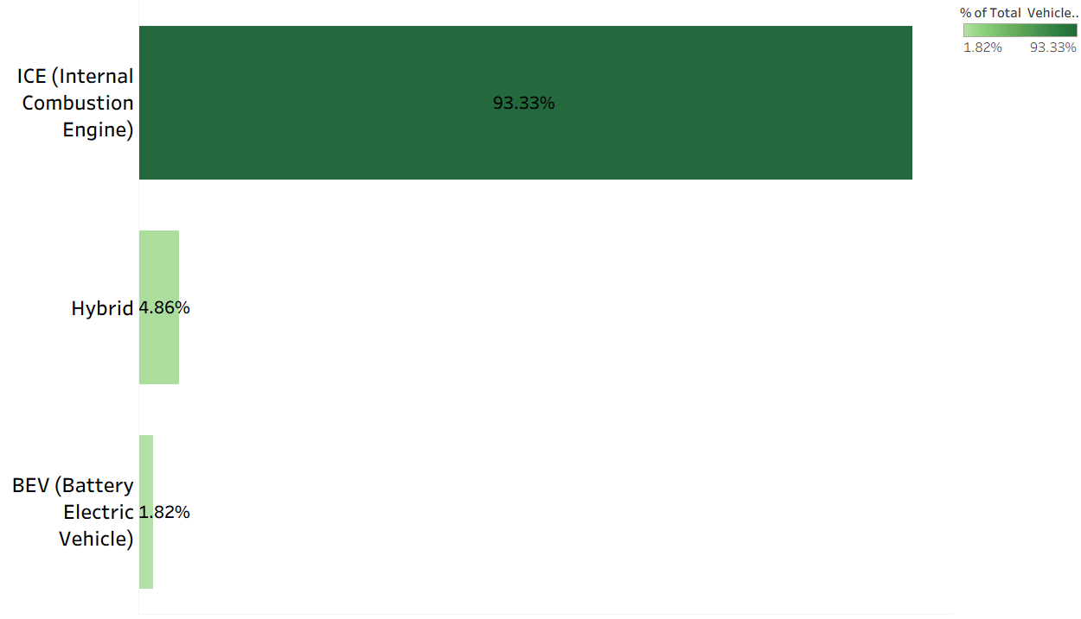
electrification level

Slide 8
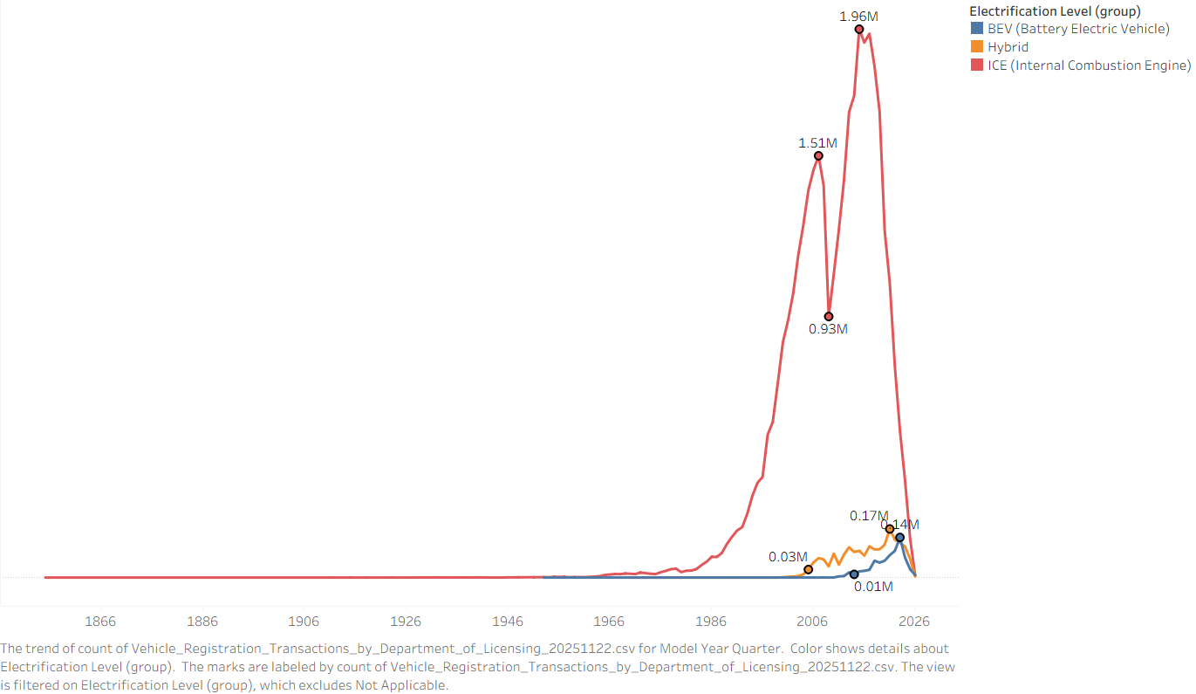
Vehicle Registrations by Electrification Level

Slide 9
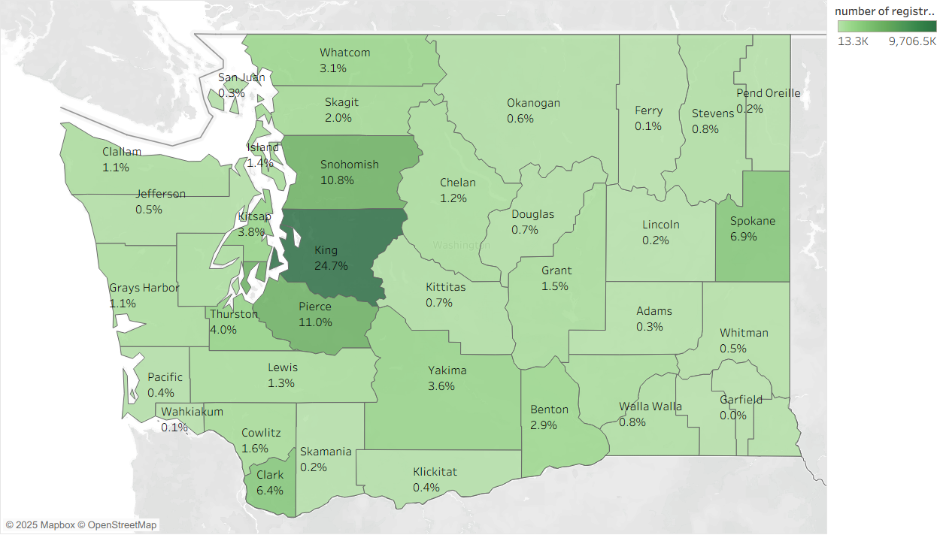
Percentage of Vehicle by County

Slide 10
What Could affect EV and Hybrid adopt EV
Population
Political leaning
Income

Slide 11
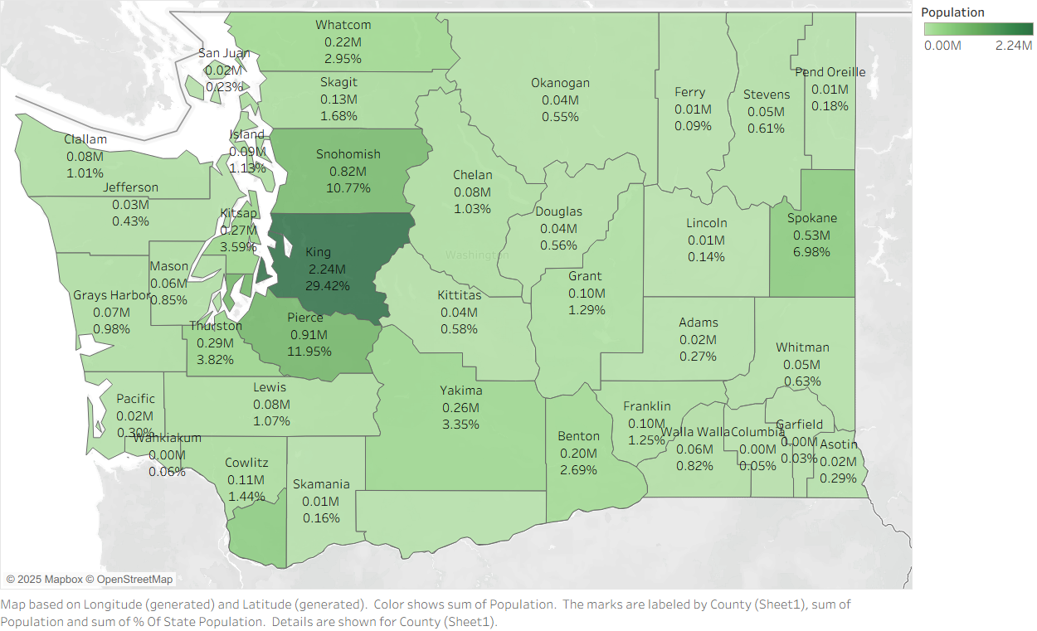
Population for each County

Slide 12
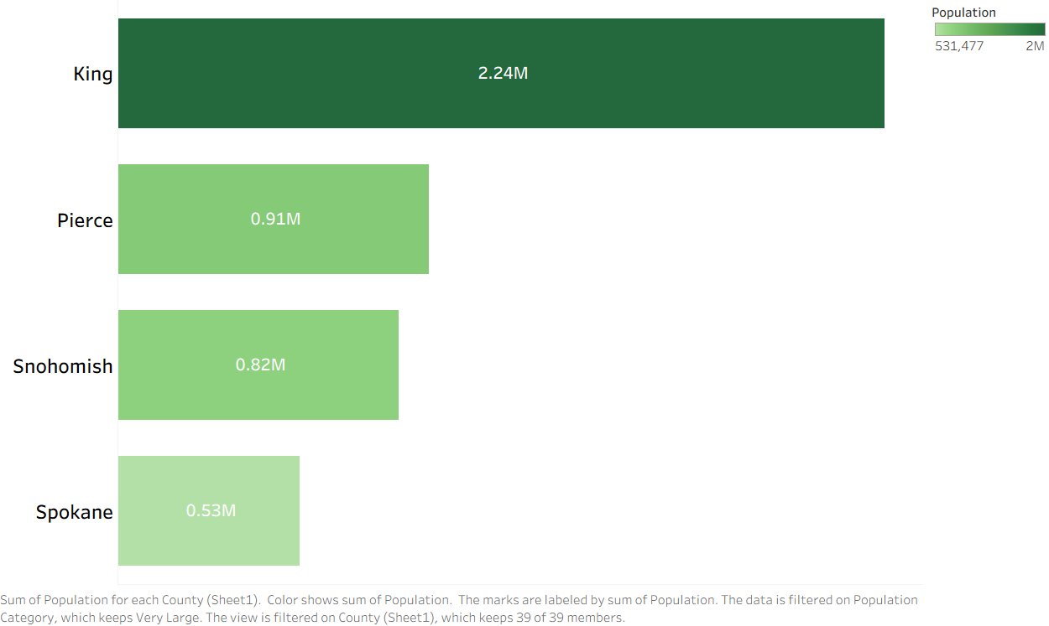
High population County

Slide 13
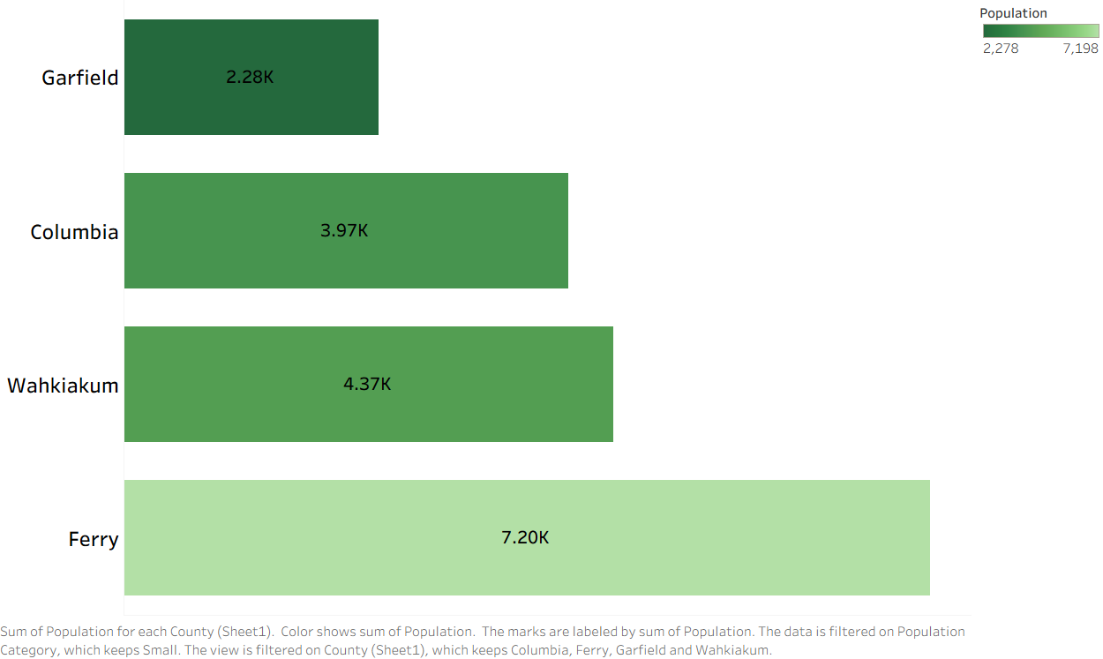
Low Population County

Slide 14
Population Analysis
7.62 M
Total Population
2.24 M
Highest County by Population
(King)
2.28 K
Lowers County by Population
(Garfield)

Slide 15
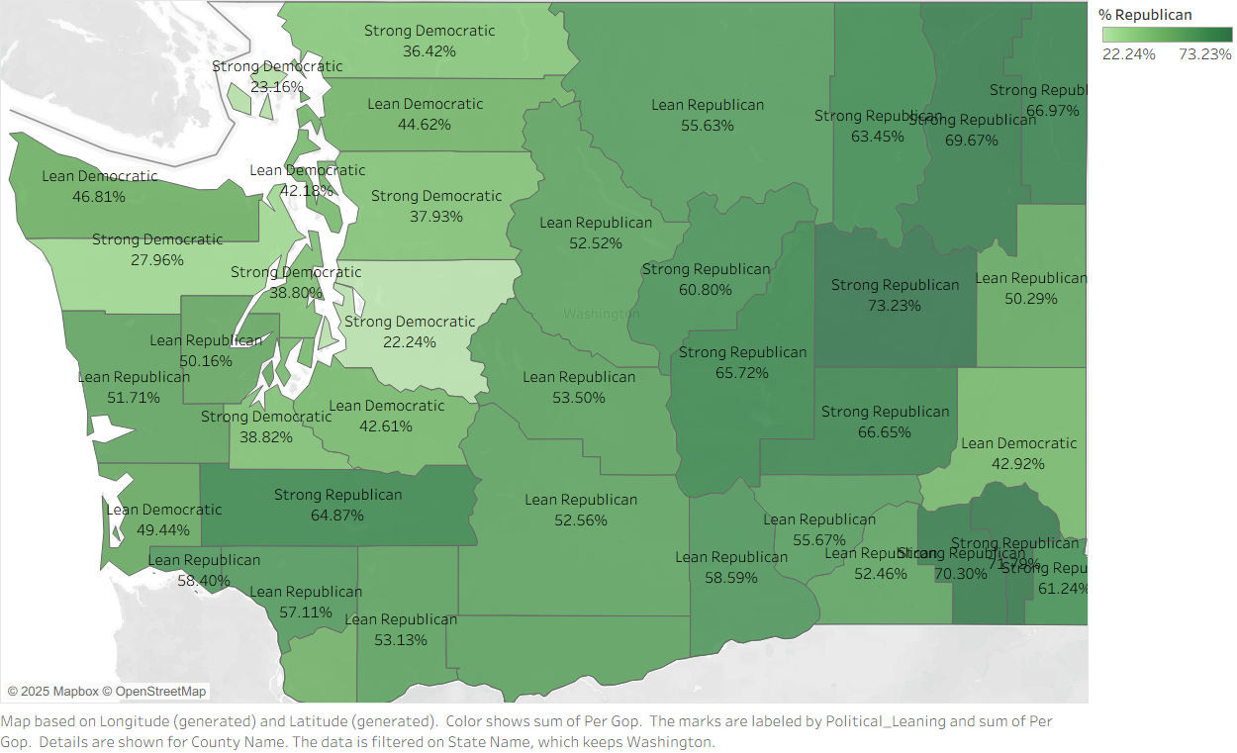
Political leaning for each County

Slide 16
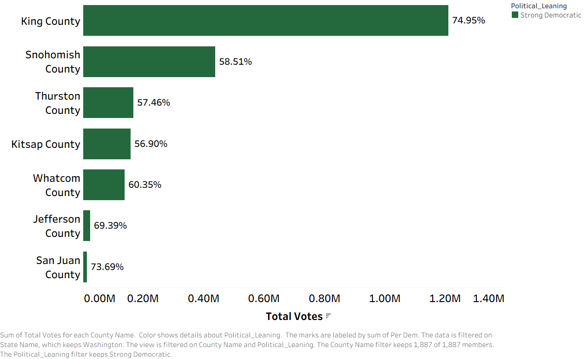
Strong Democratic County

Slide 17
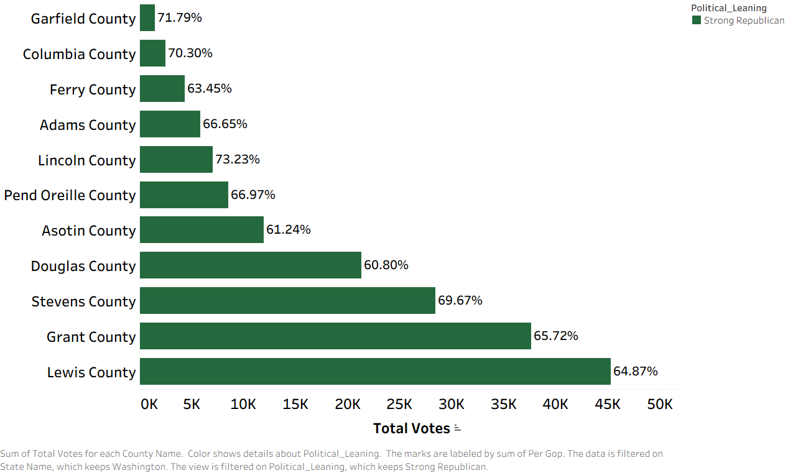
Strong Republican County

Slide 18
Political leaning Analysis
4M
Total Votes in 2024 Elections
74.95%
Strongest Democratic County
(King)
71.79%
Strongest Republican County
(Garfield)

Slide 19
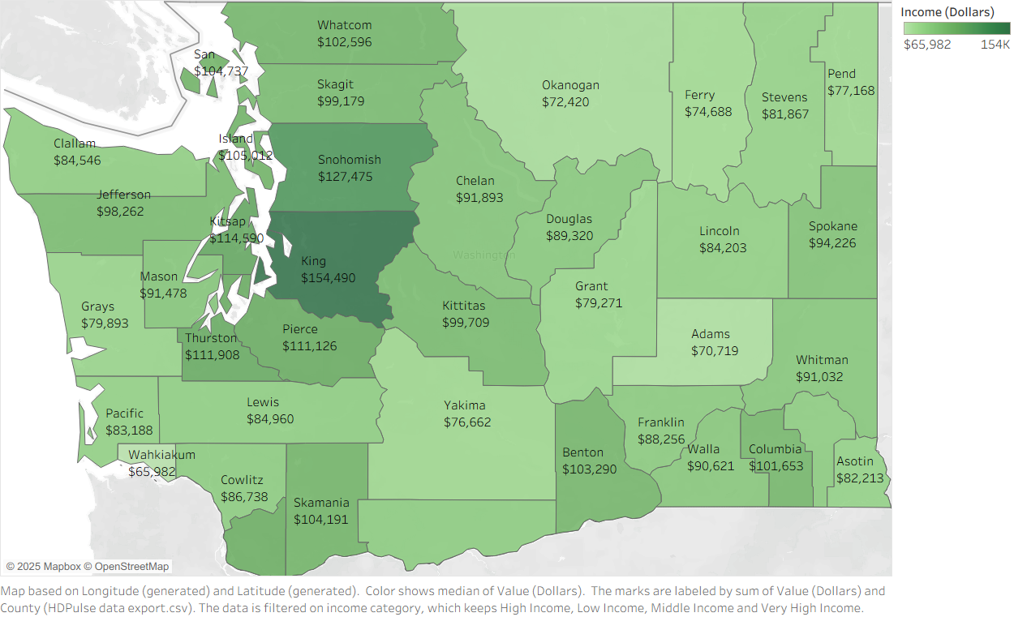
Median Income by County

Slide 20
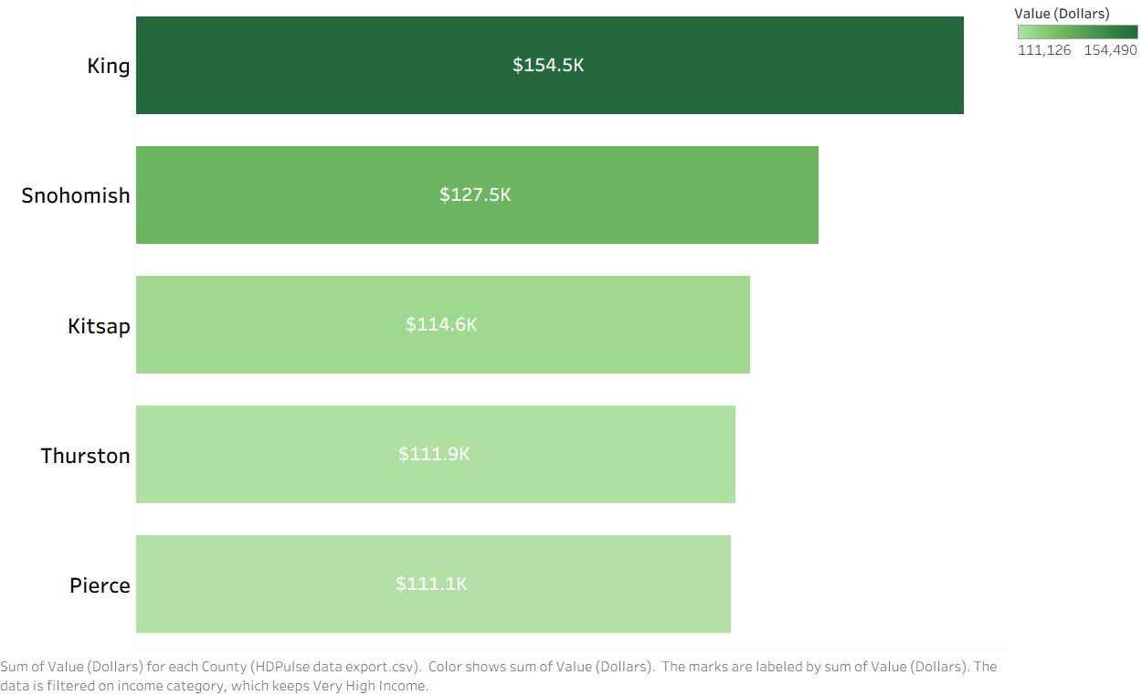
High Median Income County

Slide 21
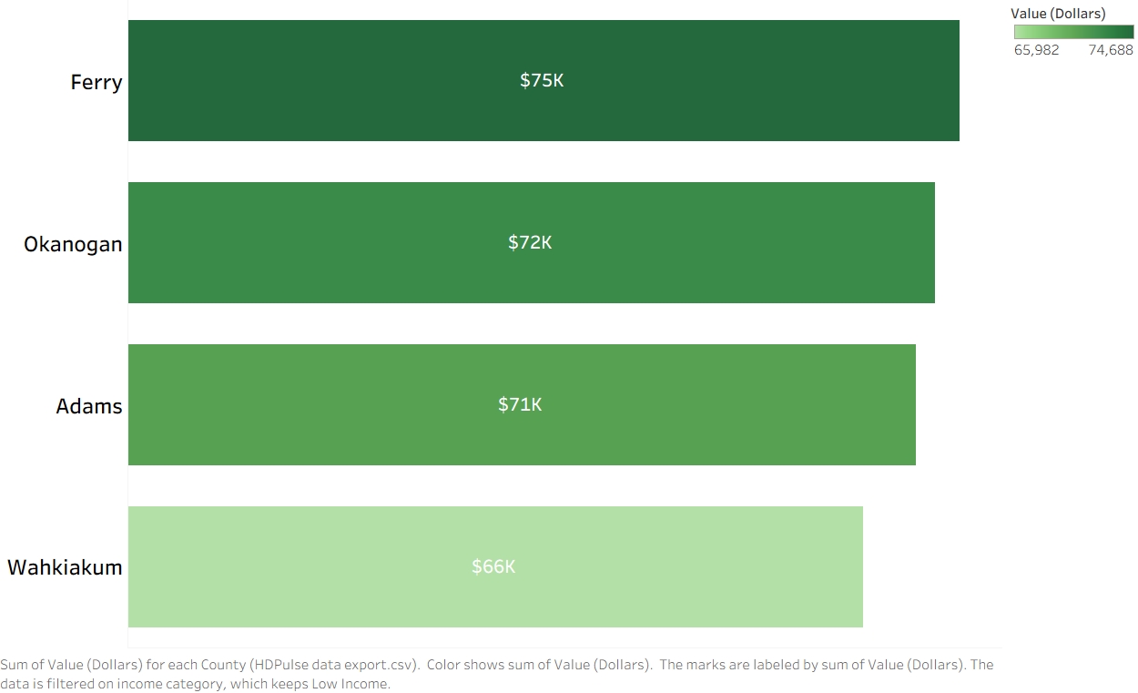
Low Median Income County

Slide 22
Income Analysis
114K $
Median income for Washington
154k $
Highest Median Income
(King)
66k $
Lowest Median Income
(Wahkiakum)

Slide 23

Percentage of ICE by County

Slide 24
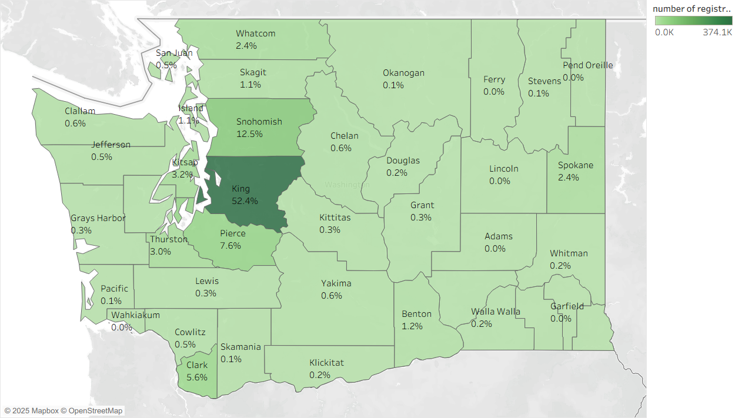
Percentage of EV by County

Slide 25
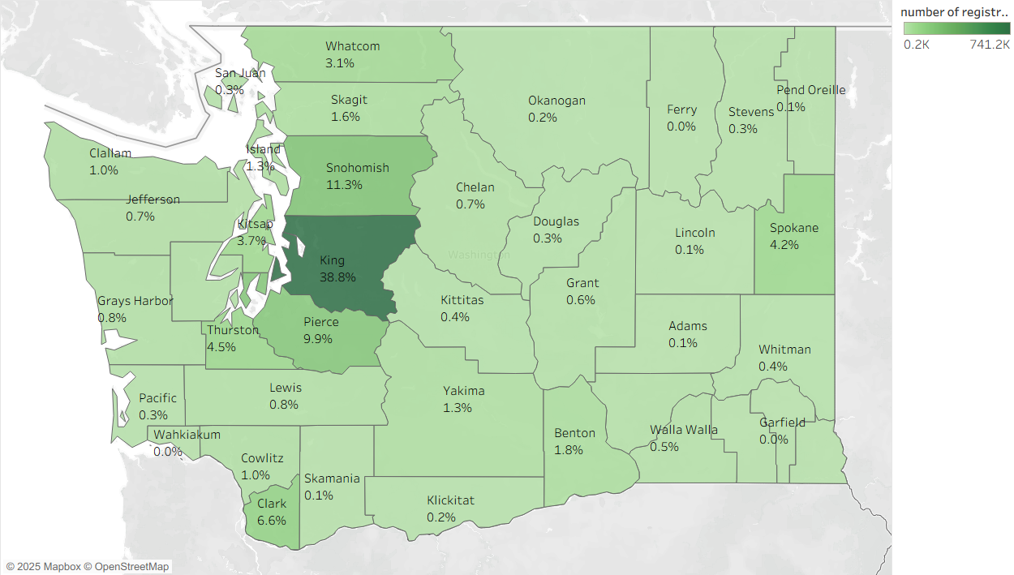
Percentage of Hybrid by County

Slide 26
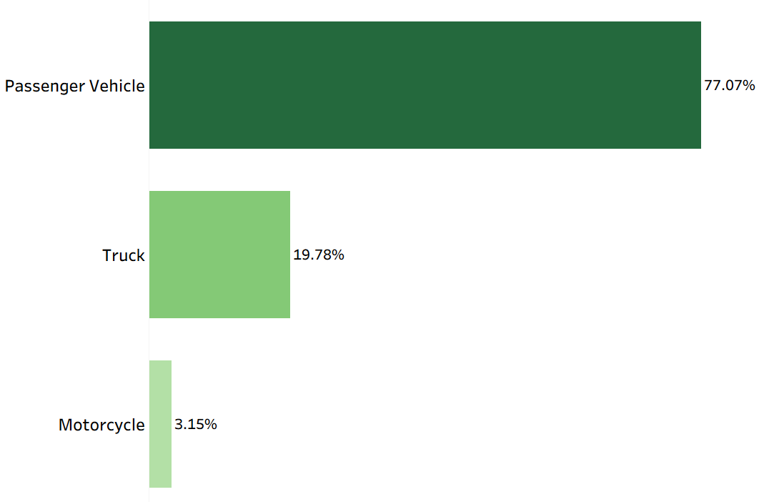
Primary Use of Vehicle

Slide 27
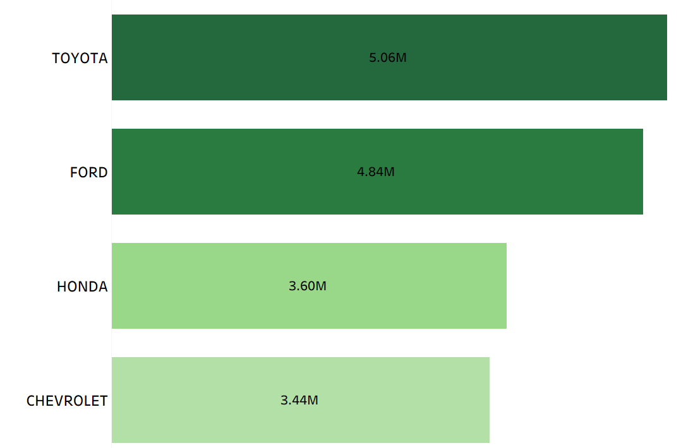
Top Registered ICE Brand

Slide 28
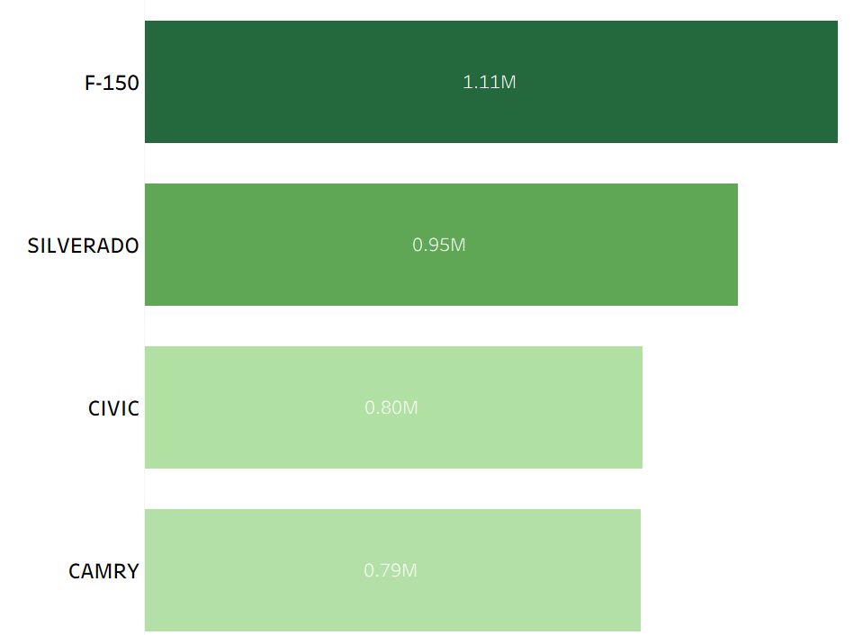




Top Registered ICE Model

Slide 29
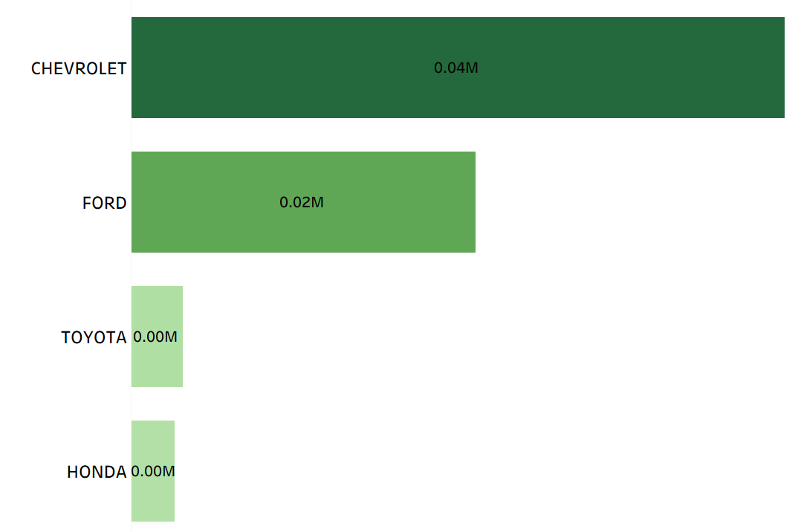
Top Registered EV Brand

Slide 30
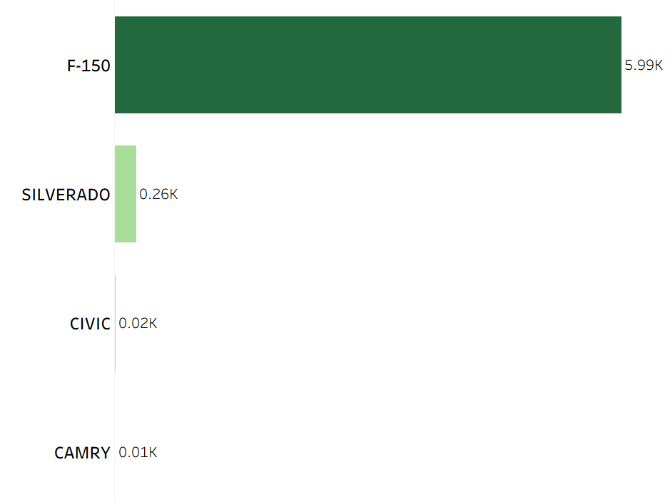
Top Registered EV Model

Slide 31
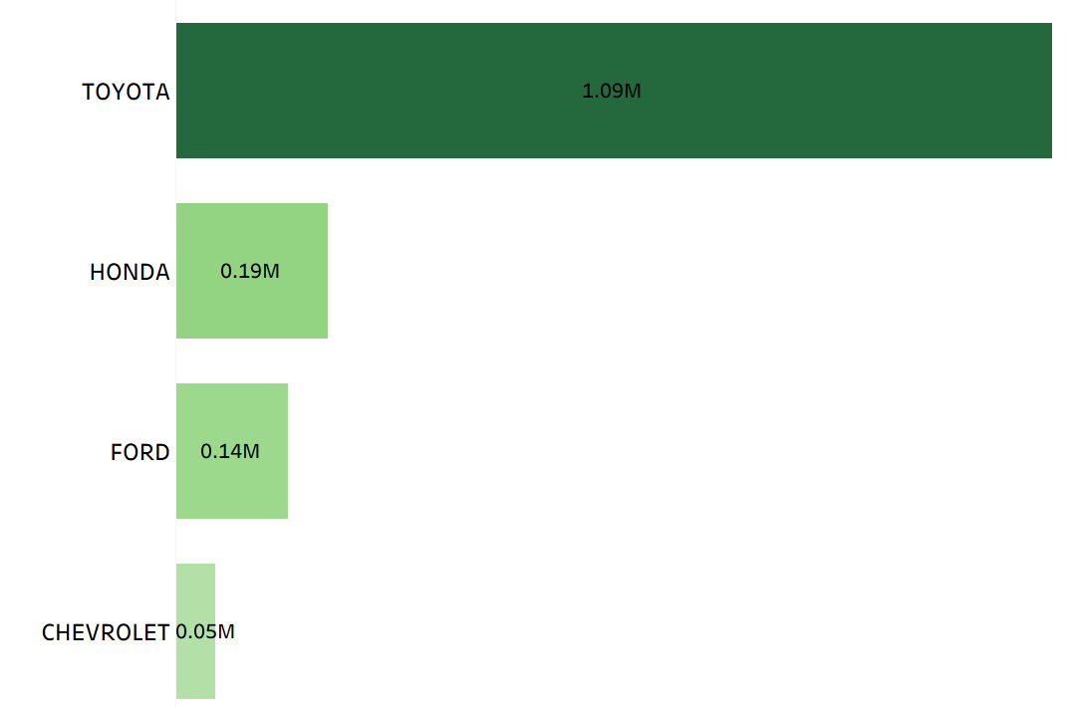
Top Registered Hybrid Brand

Slide 32
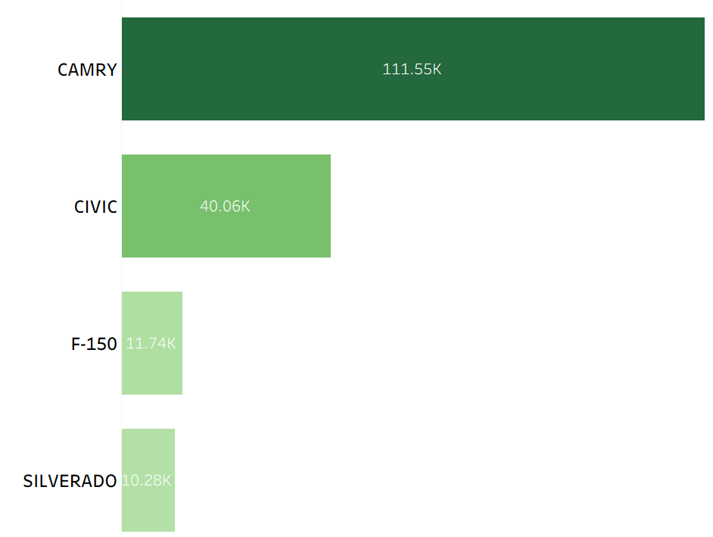
Top Registered Hybrid Model

Slide 33
Rcommendations
Incentivize Affordability
Tailored Awareness Campaigns
Promote Hybrid Vehicles as Transition Options
Enhance Public-Private Partnerships

Slide 34
Limitations
Data Availability
Behavioral Factors Not Captured
Correlation vs. Causation
Rapid Market Changes

Slide 35
Thanks

